Slide 1

EyeQoE: A Novel QoE Assessment Model for 360-degree Videos Using Ocular Behaviors
UbiComp’22
Huadi Zhu, Tianhao Li, Chaowei Wang, Wenqiang Jin, Srinivasan Murali, Mingyan Xiao, Dongqing Ye, Ming Li
The University of Texas at Arlington

Slide 2
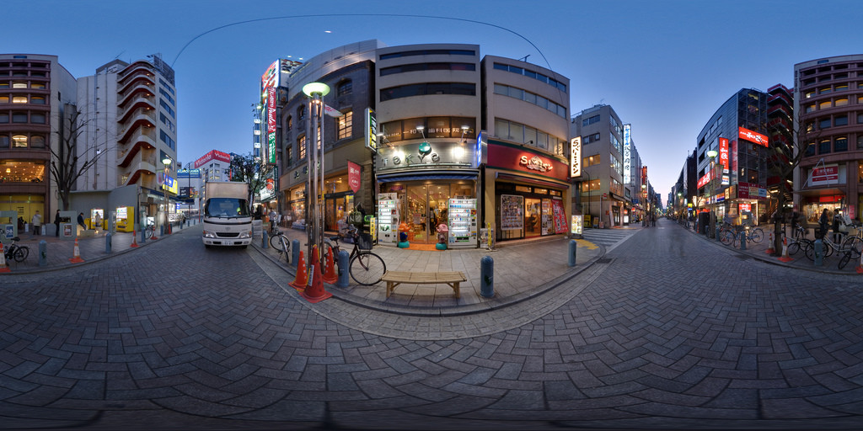




Motivation: 360-degree Video Streaming
Immersive & interactive experience
It is important for network/service providers to get in-depth understanding of user experience
Extremely high bandwidth requirement
Video Resolution | Required Bandwidth | Field of View Area | Visual Experience
1080×720 (HD) | 2.5 Mbps | 270×360
1920×1080 (FHD) | 5 Mbps | 480×540
2560×1440 (2K) | 12 Mbps | 640×720
3840×2160 (4K) | 25 Mbps | 960×1080
7680×4320 (8K) | >50 Mbps | 1920×2160
Beyond network capacity!
Notes:
(C) As a new type of multimedia, 360-degree videos offer an immersive and interactive experience for watchers, and have attracted considerable attention from academia and industry.
(C) However, streaming such videos requires extremely high bandwidth, (C) since users only see a small portion of a frame but the entire frame needs to be streamed following the strategy of commercial services,
(C) It turns out that such videos can only be streamed at 8K resolution to guarantee good visual experience,
(C) But it seriously exceeds the network capacity of home WiFi and may lead to even more hazardous events.
(C) Therefore, network and service providers have to strike a balance between resource consumption and service quality for 360-degree video streaming. To do that, it is important for them to get in-depth understanding of user experience…

Slide 3


Motivation: QoE Assessment
It is important for network/service providers to get in-depth understanding of user experience
Protocol design
Codec development
Adaptive streaming
……
Quality of Experience (QoE)
QoE reflects the actual user experience of watching the video
Difficult to derive accurate and convenient QoE assessment
Notes:
(C) …so that they can take necessary actions in service management, such as ….
(C) One critical evaluation indicator is quality of experience, or called QoE, which is a measure of how users subjectively perceives an application or service.
(C) On the one hand, QoE reflects the actual user experience of watching videos.
(C) On the other hand, however, it is difficult to measure QoE accurately and conveniently from external indicators.

Slide 4
Related Work
Current solutions: Manual reports and surveys – time consuming and inconvenient
Existing automated QoE assessment schemes
Video-centric models
Visual attention enhanced models
Spherical-PSNR ^{[1]}
VQA-OV ^{[5]}
Accurate, convenient, human-labor free!
Spherical-SSIM ^{[2]}
V-CNN ^{[6]}
Weighted-Spherical-PSNR ^{[3]}
Pixel-wise Distortion ^{[7]}
Weighted-Spherical-SSIM ^{[4]}
Facial Expression + Gaze ^{[8]}
[1] Yu, Matt, Haricharan Lakshman, and Bernd Girod. "A framework to evaluate omnidirectional video coding schemes." 2015 IEEE international symposium on mixed and augmented reality. IEEE, 2015.
[2] Chen, Sijia, et al. "Spherical structural similarity index for objective omnidirectional video quality assessment." 2018 IEEE international conference on multimedia and expo (ICME). IEEE, 2018.
[3] Sun, Yule, Ang Lu, and Lu Yu. "Weighted-to-spherically-uniform quality evaluation for omnidirectional video." IEEE signal processing letters 24.9 (2017): 1408-1412.
[4] Zhou, Yufeng, et al. "Weighted-to-spherically-uniform SSIM objective quality evaluation for panoramic video." 2018 14th IEEE International Conference on Signal Processing (ICSP). IEEE, 2018.
[5] Li, Chen, et al. "Bridge the gap between VQA and human behavior on omnidirectional video: A large-scale dataset and a deep learning model." Proceedings of the 26th ACM international conference on Multimedia. 2018.
[6] Li, Chen, et al. "Viewport proposal CNN for 360 video quality assessment." 2019 IEEE/CVF Conference on Computer Vision and Pattern Recognition (CVPR). IEEE, 2019.
[7] Xu, Mai, et al. "Assessing visual quality of omnidirectional videos." IEEE transactions on circuits and systems for video technology 29.12 (2018): 3516-3530.
[8] Porcu, Simone, et al. "Estimation of the quality of experience during video streaming from facial expression and gaze direction." IEEE Transactions on Network and Service Management 17.4 (2020): 2702-2716.
Notes:
(C) In current multimedia services, user’s QoE is mainly obtained by asking people to manually report their perceived quality or via surveys after a video session.
(C) Such procedures are time-consuming and inconvenient for the users, so in reality, most people would simply skip this procedure.
(C) To address this issue, prior efforts have been devoted to developing automated QoE assessment schemes. These schemes can be divided in two directions, video-centric models that rely on objective video quality metrics, and visual attention enhanced models, that incorporate users’ visual attention for better prediction.
However, all these approaches are criticized for overlooking subjective feelings of users. For example, a user may rate a lower QoE when feeling tired, which is not caused by the video quality but due to her own feelings, which cannot be accounted in these schemes.
(C) It is thus crucial to develop a QoE assessment scheme that accurately and conveniently reflects a user’s perception with no human labor.

Slide 5
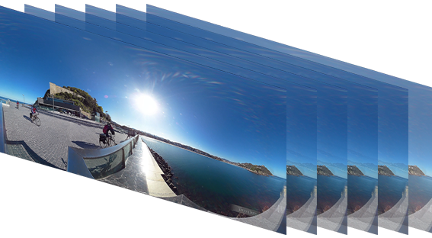


Key Observations: QoE – Eye-based Cues
Impact of video quality
Pattern consistency
Video frames
4K
1080p
720p
4K, 2nd trial
Gaze patterns
Notes:
Before introducing our scheme, I would like to present our key observations regarding the relationship between QoE and ocular behaviors, or eye-based cues, such as gazes, blinks, and pupil size.
(C) Here are some examples of the same frames in a video. The first three videos have different visual qualities; the last video has the same quality as the first one.
(C) We observe that the corresponding gaze patterns are different across the first three videos.
(C) This indicates that such eye-based cues are impacted by the objective factors such as visual quality.
(C) We also observe that gaze patterns remain consistent under the same quality.

Slide 6
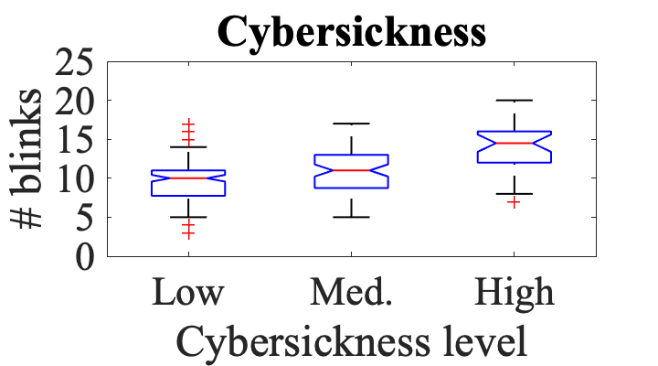
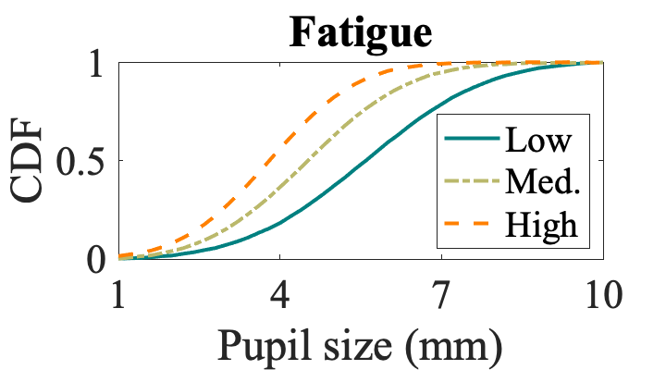
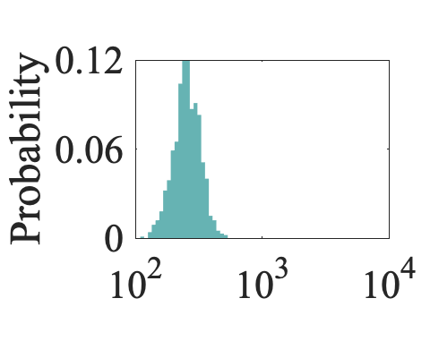
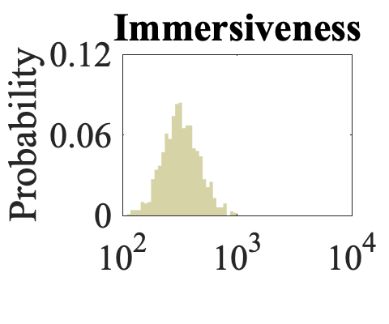
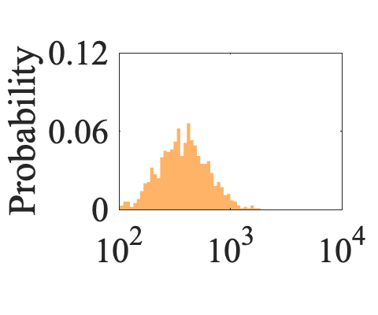
Key Observations: QoE – Eye-based Cues
Impact of subjective factors
Cybersickness
Fatigue
Immersiveness
……
Gaze vergence distance (mm)
Notes:
(C) Besides the objective factors, we next study the impact of several subjective factors from the distributions of the eye-based cues.
We show that (C) cybersickness, (C) fatigue, and (C) immersiveness can be reflected from multiple eye-based cues such as the number of blinks, the pupil size, and the gaze vergence distance.

Slide 7
EyeQoE: Proposed Idea
Basic idea
Leverage eye-based cues to infer subjects’ QoE in watching 360-degree videos
Challenges and countermeasures
Data modeling and representation learning
Graph modeling
GCN
Dealing with subjects and visual stimuli heterogeneity
Data selection
Siamese network
Dealing with unseen videos
Video type categorization
Multi-source adversarial domain adaption (MADA)
Notes:
(C) Based on these observations, we propose EyeQoE; its basic idea is using subjects’ eye-based cues to infer their QoE during the video watching session.
(C) Although the idea sounds simple, implementing it involves several non-trivial challenges.
The first challenge is data modeling and representation learning from these eye-based cues. To address this issue, we propose a novel algorithm to model the data into graphs and employ graph convolutional network, or GCN, to infer the QoE.
(C) The second challenge is dealing with heterogeneity. To this end, we develop a Siamese network for model training with carefully selected input data to get rid of irrelevant factors.
(C) The third challenge is preserving performance for unseen videos. To deal with this issue, we propose a video type categorization algorithm and a domain adaption approach.

Slide 8
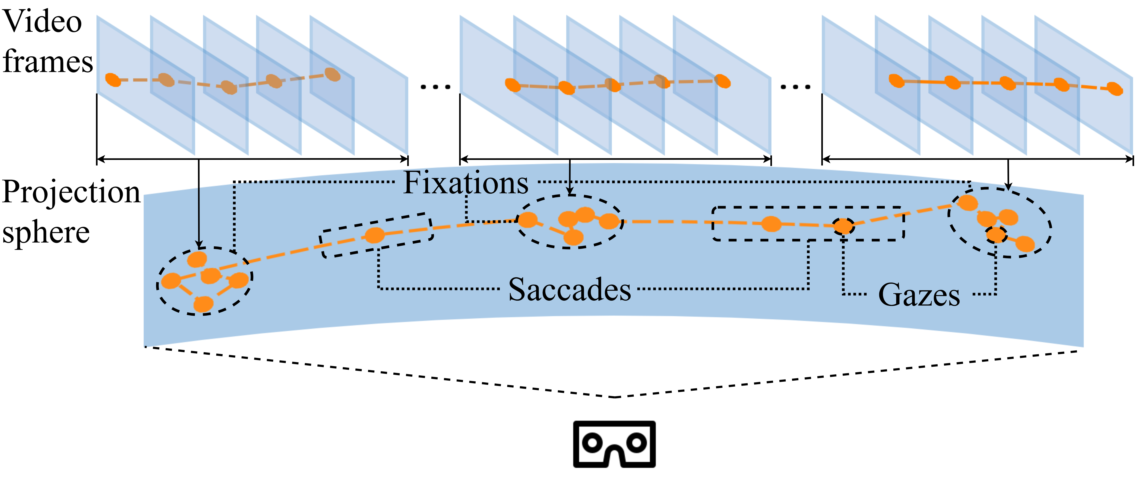
Modeling Ocular Behaviors into Graphs
Video frames - gaze map
Gazes
Fixations
Saccades
Node-edge structure – graph!
Notes:
(C) Our first step is to model eye-based cues, from gazes, fixations, and saccades, across the entire video.
(C) A gaze is the real-time visual point where the user is looking at.
(C) A fixation consists of a time series of gazes focused around a target.
(C) A saccade is a set of fast-moving gazes between two fixations.
(C) The fixations and saccades resemble the typical node-edge structure, which inspires us to model the entire gaze map into a graph.

Slide 9
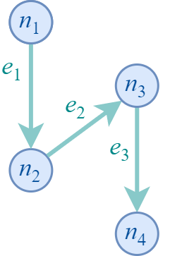
Modeling Ocular Behaviors into Graphs
Basic version:
Fixations ☞ nodes
Eye-based cues on the same target
Saccades ☞ (directional) edges
Eye-based cues during switching targets
Chronological order
Temporal dependency
Notes:
(C) We start by showing a basic graph modeling algorithm,
(C) where we model fixations into nodes,
(C) and saccades into directional edges.
Fixations are attributed by eye-based cues on the same target, and saccades are from those during switching targets in a chronological order.
(C) In short, the basic graph preserves the temporal dependency of the visual attention.

Slide 10
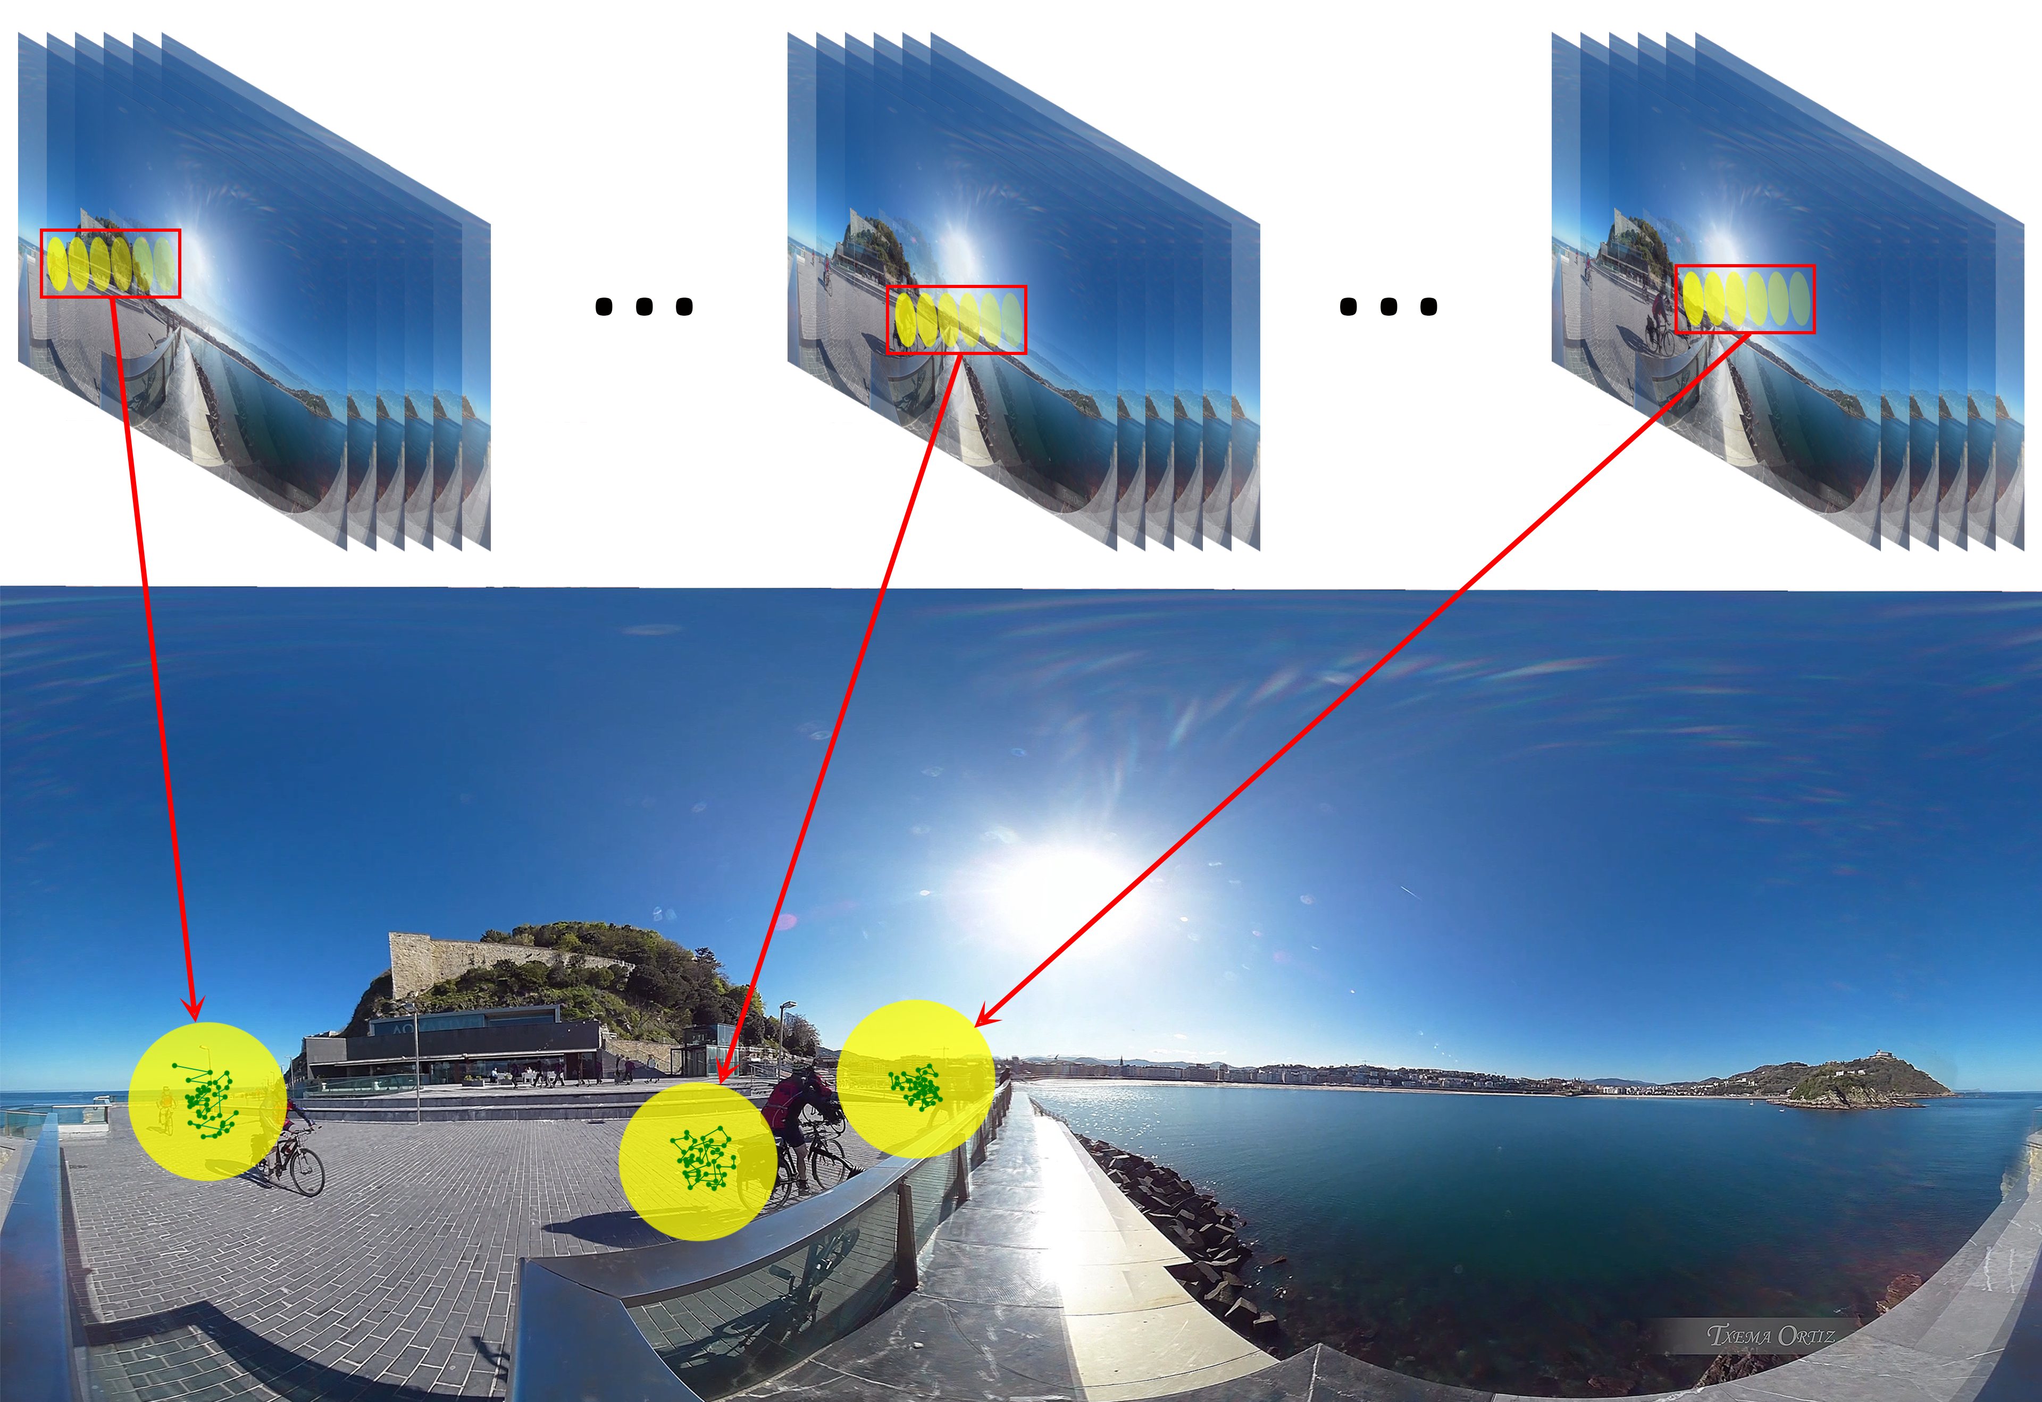
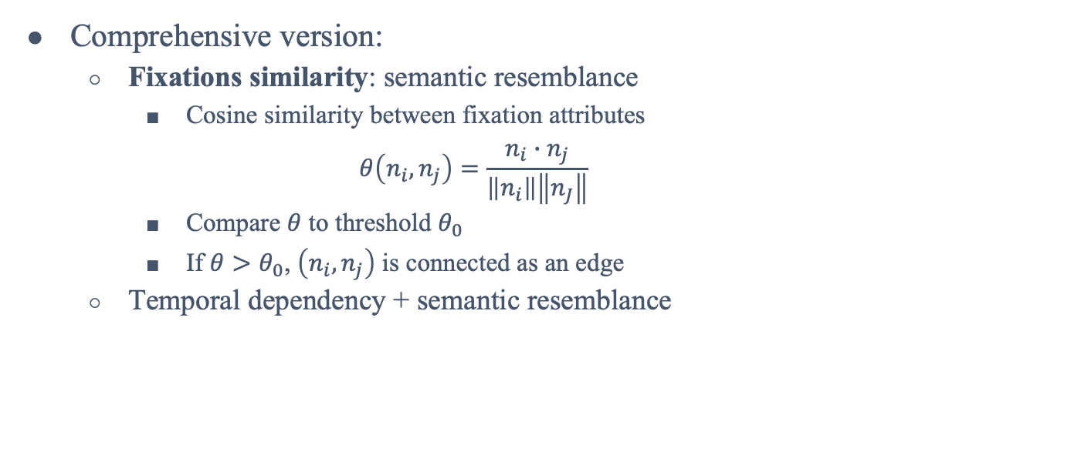
Modeling Ocular Behaviors into Graphs
Comprehensive version:
Fixations similarity: semantic resemblance
Cosine similarity between fixation attributes $θ\left(n_{i},n_{j}\right)=\frac{n_{i}∙n_{j}}{\left\|n_{i}\right\|\left\|n_{J}\right\|}$
Compare $θ$ to threshold $θ_{0}$
If $θ>θ_{0}$, $\left(n_{i},n_{j}\right)$ is connected as an edge
Temporal dependency + semantic resemblance
0.33
0.27
0.75
0.84
0.5
0.67
Notes:
(C) Following the basic version, we further explore relationships in other domains, and propose a comprehensive version.
This is based on our observation that, two fixations often share high similarities in their attributes if they are focused on the same object. This is known as the semantic resemblance across fixations.
In this example, the three fixations share high similarity as they are focused on the same biker at different time.
(C) To incorporate the semantic resemblance in the graph, we first compute the cosine similarity between each two fixations,
(C) then we compare the similarity to a pre-defined threshold, and
(C) if it’s larger than the threshold, an edge is added between these two fixations.
(C) The comprehensive model has two types of edges that preserve the temporal dependency and the semantic resemblance, respectively.

Slide 11
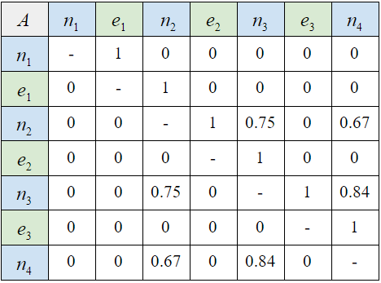
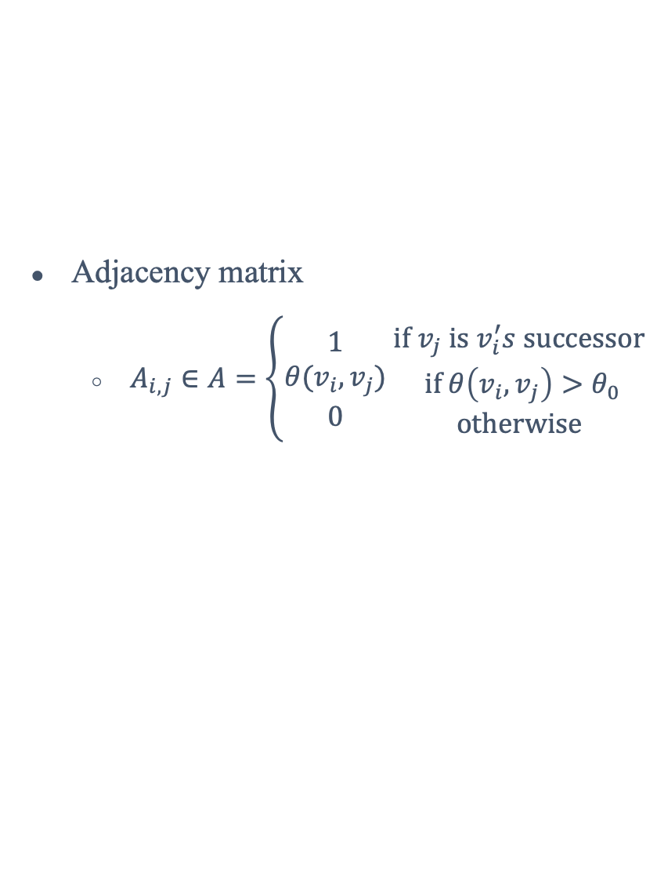

Matrices Construction
Attribute matrix
Aggregate attributes for each fixation/saccade
Encode into the same dimension
Adjacency matrix
$A_{i,j}∈A=\left\{\begin{aligned}1 \\ θ(v_{i},v_{j}) \\ 0\end{aligned} \begin{matrix}if v_{j} is v_{i}^{′}s successor \\ if θ\left(v_{i},v_{j}\right)>θ_{0} \\ otherwise\end{matrix}\right.$
n₁
e₁
$$X$$
n₂
…
Encoding
…
Notes:
(C) Next, we construct the matrices which will be input to the GCN.
(C) The attribute matrix is constructed by aggregating different types of eye-based cues in each fixation and saccade.
(C) Since they have different time lengths, an encoding process is introduced to encode each fixation and saccade into the same dimension.
(C) Then, each fixation is connected to its next saccade with a weight of 1, and the weight between each two fixations is derived following the process discussed before.
(C) In this way, we obtain the adjacency matrix of the comprehensive graph.

Slide 12
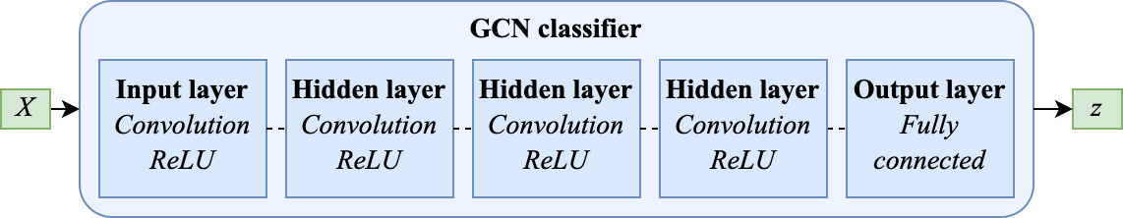
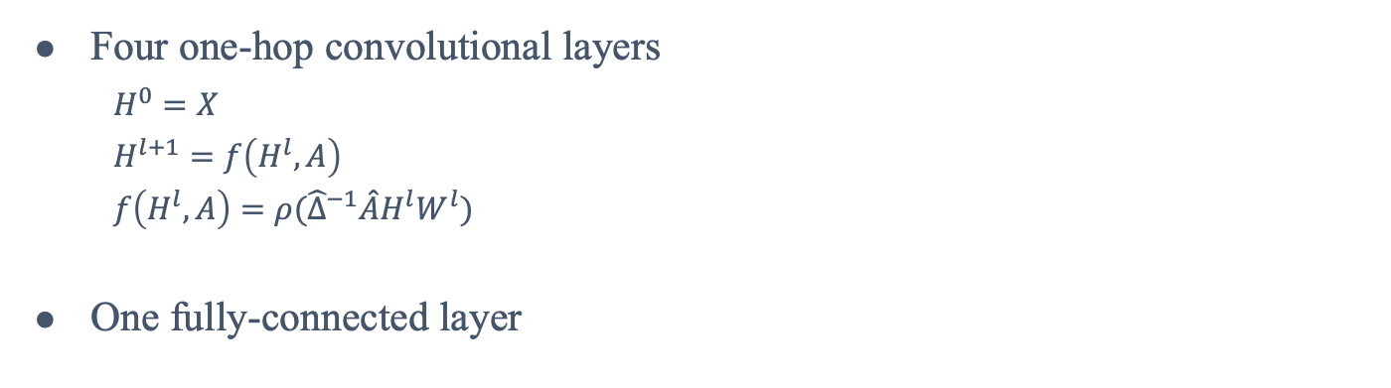
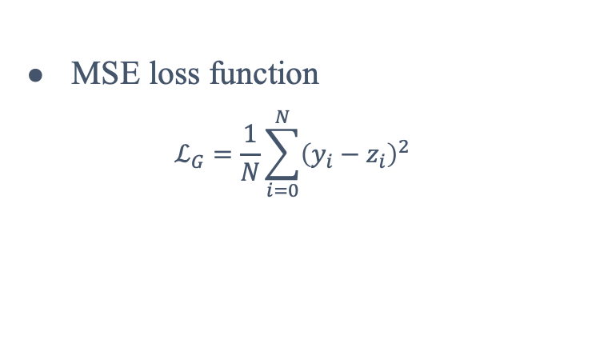
GCN-based QoE Assessment Model
MSE loss function
$$ℒ_{G}=\frac{1}{N}\sum_{i=0}^{N}{{\left(y_{i}−z_{i}\right)}^{2}}$$
Four one-hop convolutional layers
$H^{0}=X$
$H^{l+1}=f\left(H^{l},A\right)$
$f\left(H^{l},A\right)=ρ({\hat{Δ}}^{−1}\hat{A}H^{l}W^{l})$
One fully-connected layer
Notes:
We construct a GCN classifier to learn from the graph and predict the QoE score.
(C) The classifier consists of 4 convolutional layers before an FC layer; in each layer the representations are extracted from the last layer’s output.
(C) The FC layer produces the final QoE score.
(C) The MSE loss function is adopted.

Slide 13
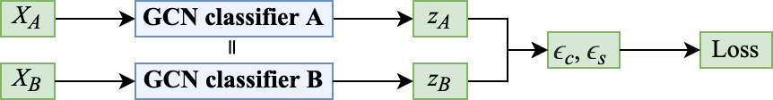
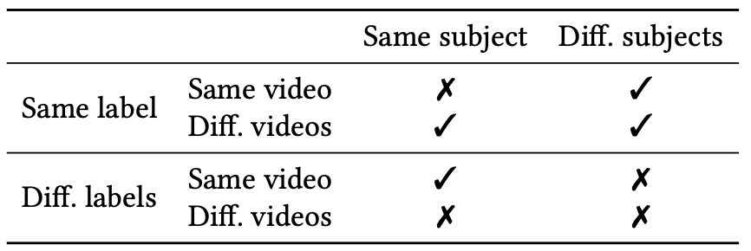
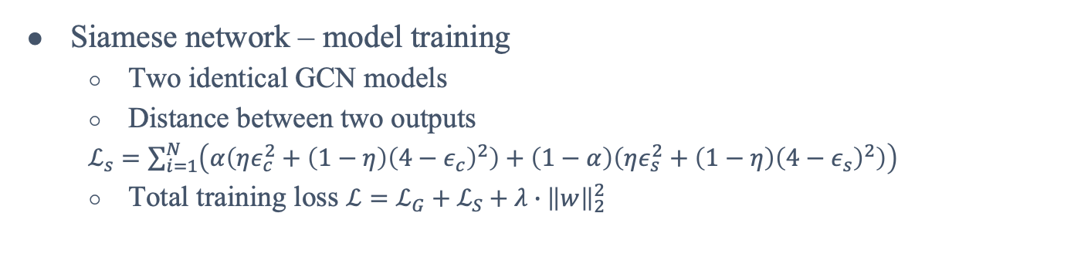
Dealing with Subjects and Visual Stimuli Heterogeneity
Training pair selection rule
Heterogeneous pair with same labels
Homogeneous pair with different labels
Siamese network – model training
Two identical GCN models
Distance between two outputs
$ℒ_{s}=\sum_{i=1}^{N}{\left(α\left(ηε_{c}^{2}+\left(1−η\right){\left(4−ε_{c}\right)}^{2}\right)+\left(1−α\right)\left(ηε_{s}^{2}+\left(1−η\right){\left(4−ε_{s}\right)}^{2}\right)\right)}$
Total training loss $ℒ=ℒ_{G}+ℒ_{S}+λ∙{\left\|w\right\|}_{2}^{2}$
Notes:
To get rid of irrelevant factors such as the heterogeneity among subjects and video contents, we employ a Siamese network for the model training.
(C) The network takes a pair of samples as input. We adopt a carefully designed rule for training pair selection, such that only heterogeneous pairs with the same labels and homogeneous pairs with different labels are selected.
(C) Then, these pairs are fed into two identical GCN models that share the same weights.
(C) The L2-distance between two outputs is computed as the loss.
(C) Finally, the total training loss is derived as the combination of this distance loss and the MSE loss mentioned before.
Our goal is to make the models learn through training to disregard subjects and visual stimuli heterogeneity, and only focus on QoE-related factors, which cause the label difference.

Slide 14
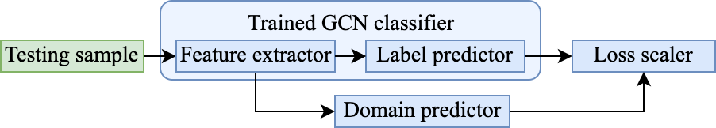
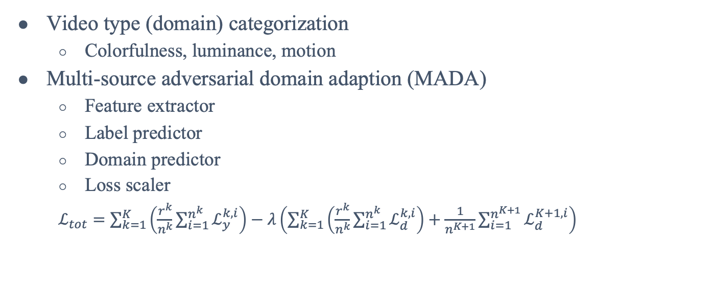
Dealing with Unseen Videos
Video type (domain) categorization
Colorfulness, luminance, motion
Multi-source adversarial domain adaption (MADA)
Feature extractor
Label predictor
Domain predictor
Loss scaler
$ℒ_{tot}=\sum_{k=1}^{K}{\left(\frac{r^{k}}{n^{k}}\sum_{i=1}^{n^{k}}{ℒ_{y}^{k,i}}\right)}−λ\left(\sum_{k=1}^{K}{\left(\frac{r^{k}}{n^{k}}\sum_{i=1}^{n^{k}}{ℒ_{d}^{k,i}}\right)}+\frac{1}{n^{K+1}}\sum_{i=1}^{n^{K+1}}{ℒ_{d}^{K+1,i}}\right)$
Trained GCN classifier
Notes:
Since it is impossible to cover all types of videos in the training phase, the trained model may not be readily scalable to unseen videos.
(C) To deal with this issue, we propose to categorize videos by their colorfulness, luminance, and motion, so that the entire video space is divided into limited domains.
(C) We propose a novel domain adaption algorithm, named MADA, to adapt the trained model from the multiple source domains to the target domain based on adversarial learning. For more details, please refer to our paper.

Slide 15
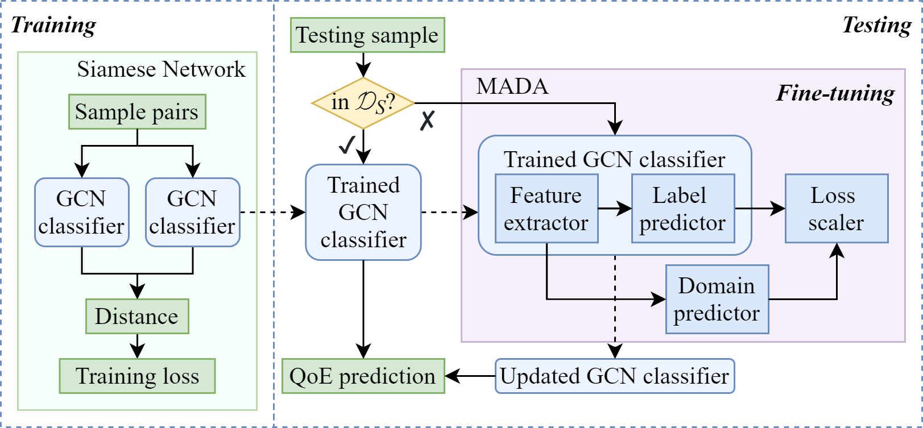
Piecing All Together
Notes:
Here we outline the overall architecture of EyeQoE.
The core component is a GCN classifier to infer QoE scores from a user’s eye-based cues.
The Siamese network trains the classifier to disregard heterogeneity.
If the tested video is not from one of the source domains that the model is trained on, MADA is activated to finetune the trained classifier to enhance its prediction.

Slide 16


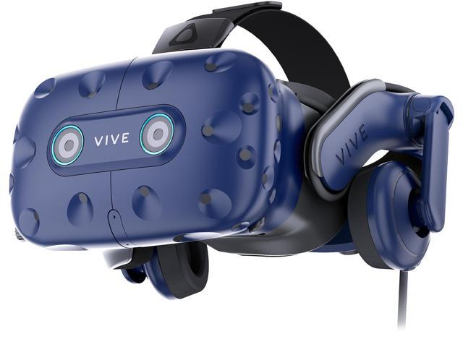





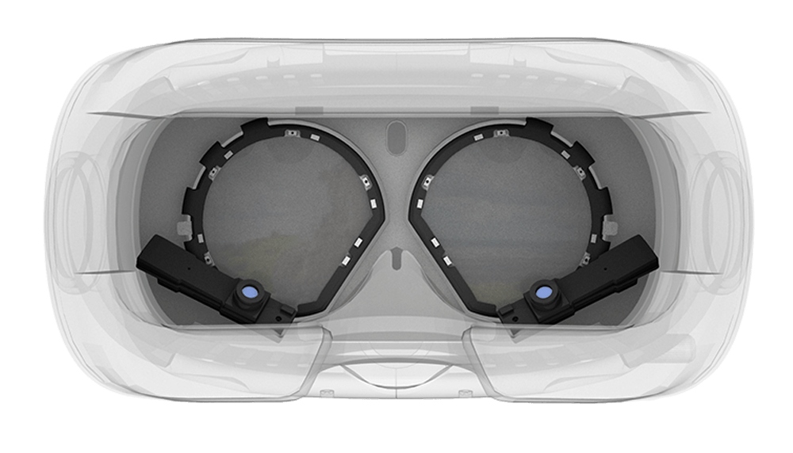

Evaluation
Experiment setup
Server: Windows 10
VR headset: HTC VIVE Pro
Eye tracker: Pupil-labs VR add-on
Dataset
Video preparation
Data collection
3-month campaign
50 participants × 130 videos = 6,500 traces
Notes:
(C) We implement EyeQoE using Unity on a local server that is physically connected with an HTC VIVE Pro VR headset. A pupil-labs eye tracker is installed inside the VR headset to capture eye data.
(C) During the experiment, 360-degree videos are rendered by the server and (C) watched by the user in the VR headset. (C) The user’s data are recorded by the eye tracker and sent back to the server, (C) where our model predicts the QoE score.
(C) After each video session, we ask the user to manually rate a QoE score from one to five, which is used as the ground truth to evaluate our scheme.
(C) We downloaded 10 video sources from YouTube and Vimeo. For each video source we prepared 13 different quality versions, resulting in a set of 130 videos in total.
(C) We conducted a 3-month data collection campaign. 50 participants were hired from our university to watch all video versions as their eye data were collected, leading to 6.5 thousand data traces. Here we illustrate the demographic distributions of these participants.

Slide 17
Evaluation
Comparison with state-of-the-arts
S-PSNR
VQA-OV
Highest prediction accuracy
S-PSNR
VQA-OV
EyeQoE (our work)
Notes:
(C) We compare the performance of EyeQoE with two state-of-the-arts, namely S-PSNR and VQA-OV.
(C) We first plot their confusion matrices.
(C) Our work demonstrates the highest accuracy.

Slide 18
Evaluation
Performance against distortions
Resolution degradation
Stalling events
EyeQoE achieves ≈0.5x smaller error than state-of-the-arts
Notes:
(C) We evaluate the prediction performance against different distortions, including (C) resolution degradation and (C) stalling events.
(C) EyeQoE constantly achieves about half of the error rate of state-of-the-arts.

Slide 19
Evaluation
Performance against distortions
Resolution degradation
Stalling events
Impact of subjective factors
Cybersickness
Fatigue
Immersiveness
EyeQoE achieves ≥ 10% higher accuracy than state-of-the-arts
Notes:
Then, we measure the impact of subjective factors, such as (C) cybersickness, (C) fatigue, (C) and immersiveness.
(C) Results indicate that EyeQoE achieves more than 10% higher accuracy compared to state-of-the-arts.

Slide 20
Evaluation
Computation latency
Preprocessing: extremely low
Graph generation: moderate
Testing (MADA): infrequently high
Acceptable time consumption
- Average time: 2.5 sec
- 90% measurements ≤ 4.2 sec
Notes:
(C) We further evaluate the computation latency of EyeQoE. The latency comes from three operations, including (C) preprocessing, which incurs extremely low latency, (C) graph generation, with moderate latency, and (C) testing, which incurs high latency due to the MADA process. Fortunately, MADA is not usually triggered.
(C) Overall, the time consumption of EyeQoE is acceptable, with an average of 2.5 seconds, and 90% can be finished within 4.2 seconds.
This duration is compatible to that of manual rating but does not involve human labor.

Slide 21


Conclusions
We present EyeQoE, a novel QoE prediction model for 360-degree videos using subjects’ eye-based cues
We have collected and publicized our extensive 360-degree video QoE assessment dataset
Comprehensive evaluations show that EyeQoE advances existing solutions
For more details please refer to our paper ☞
Our dataset is publicly available ☞
Notes:
(C) In conclusion, we present EyeQoE, a novel QoE prediction model for 360-degree videos using subjects’ eye-based cues.
(C) In the experiments, we have collected an extensive dataset which has been publicized for the community.
(C) Our comprehensive evaluations show that EyeQoE advances existing solutions.
(C) For more details, please refer to our paper.

Slide 22
Thank you!
For more details please refer to our paper ☞
Our dataset is publicly available ☞

Slide 23
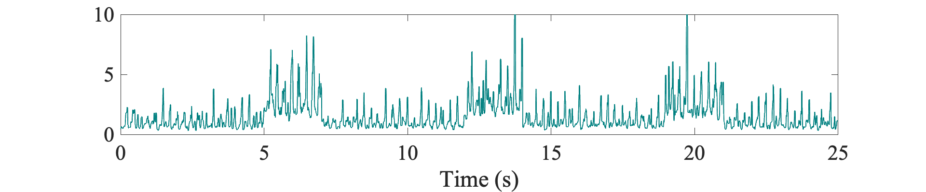
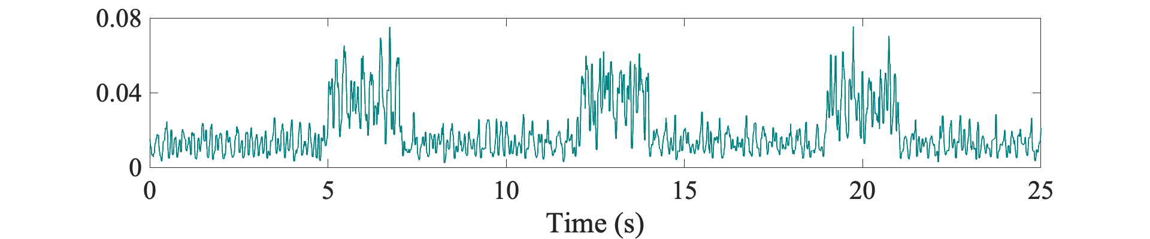
Key Observations: Eye-based Cues Reflecting QoE
Impact of video quality
Pattern Consistency
Velocity
Stalling events
Gaze distance-to-center
Notes:
(C) Apart from gaze patterns, we observe other indicators including gaze velocity and gaze distance-to-center, which are obtrusive (C) when stalling events occur. This provides more evidence for our observations.

Slide 24
Evaluation
User study
S1: The result is accurate and meets my perceived QoE score.
S2: I feel physically comfortable without dizziness or sore eyes caused by this model.
EyeQoE is well accepted by users
S3: This model does not interrupt or distract my experience of the video watching.
S4: I would like to have this model to rate QoE scores for me for practical use.
Notes:
(C) Lastly, we conducted a user study, in which each participant is asked four questions to evaluate EyeQoE from different aspects.
(C) We have gained insight that EyeQoE is well accepted by users.

